Slide 1

Rockbuster Stealth LLC Sales Analysis
Julia Petke

Slide 2
Context
Rockbuster Stealth LLC, a global movie rental company, once operated physical stores worldwide. However, with increasing competition from streaming platforms like Netflix and Amazon Prime, the Rockbuster Stealth management team is now planning to leverage its existing movie licenses to launch an online video rental service, aiming to remain competitive.

Slide 3
Objective
The objective is to analyze Rockbuster Stealth's business data and provide data-driven insights for the management's 2020 strategy
Excel, SQL, Tableau, PowerPoint, ERD

Slide 4
Key Questions
● What are Top 10 Largest customer base countries?
● What are Top 10 Cities with the Largest Customer Base in the Top 10 Countries?
● Who are the top 5 customers?
● Where are customers with a high lifetime value based?
● Who was the best Rockbuster`s Sales Personnel?

Slide 5
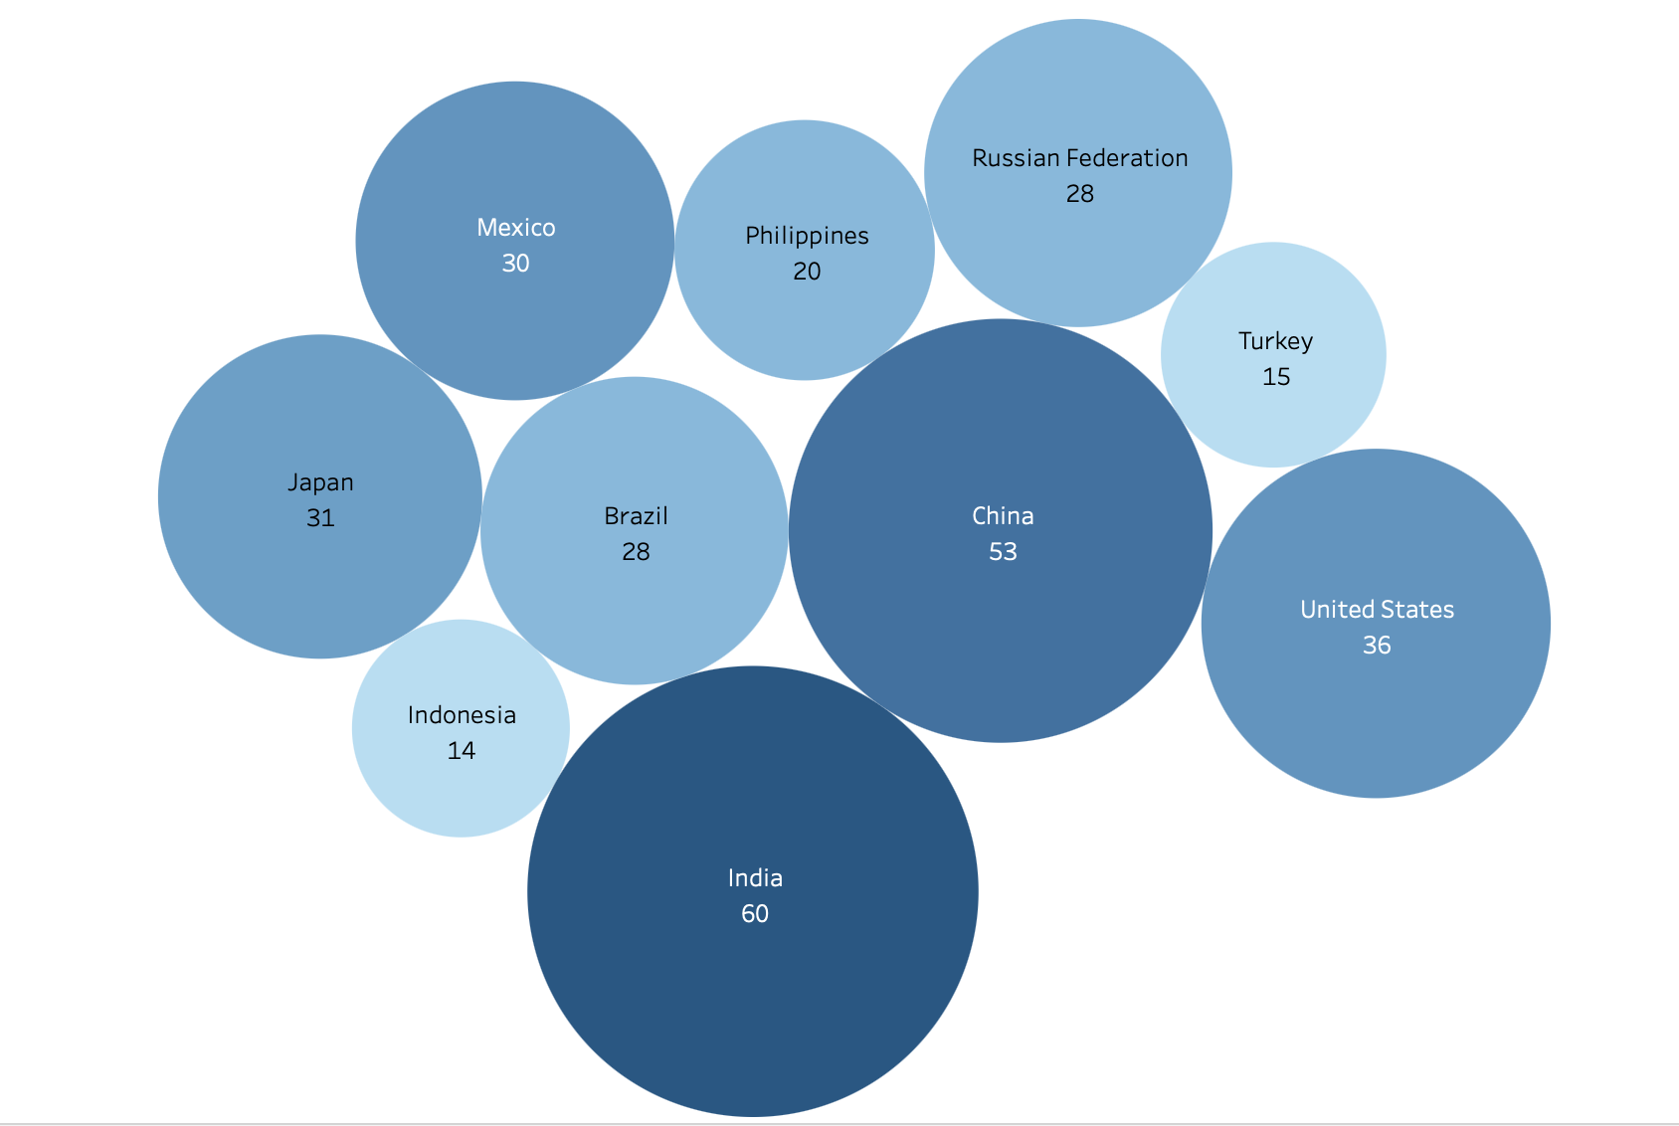
Top 10 Largest customer base countries

Slide 6
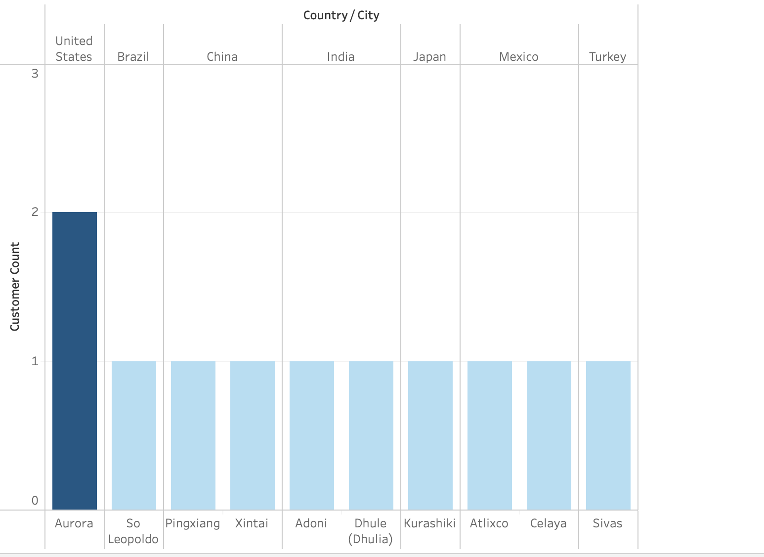
Top 10 Cities with the Largest Customer Base in the Top 10 Countries

Slide 7
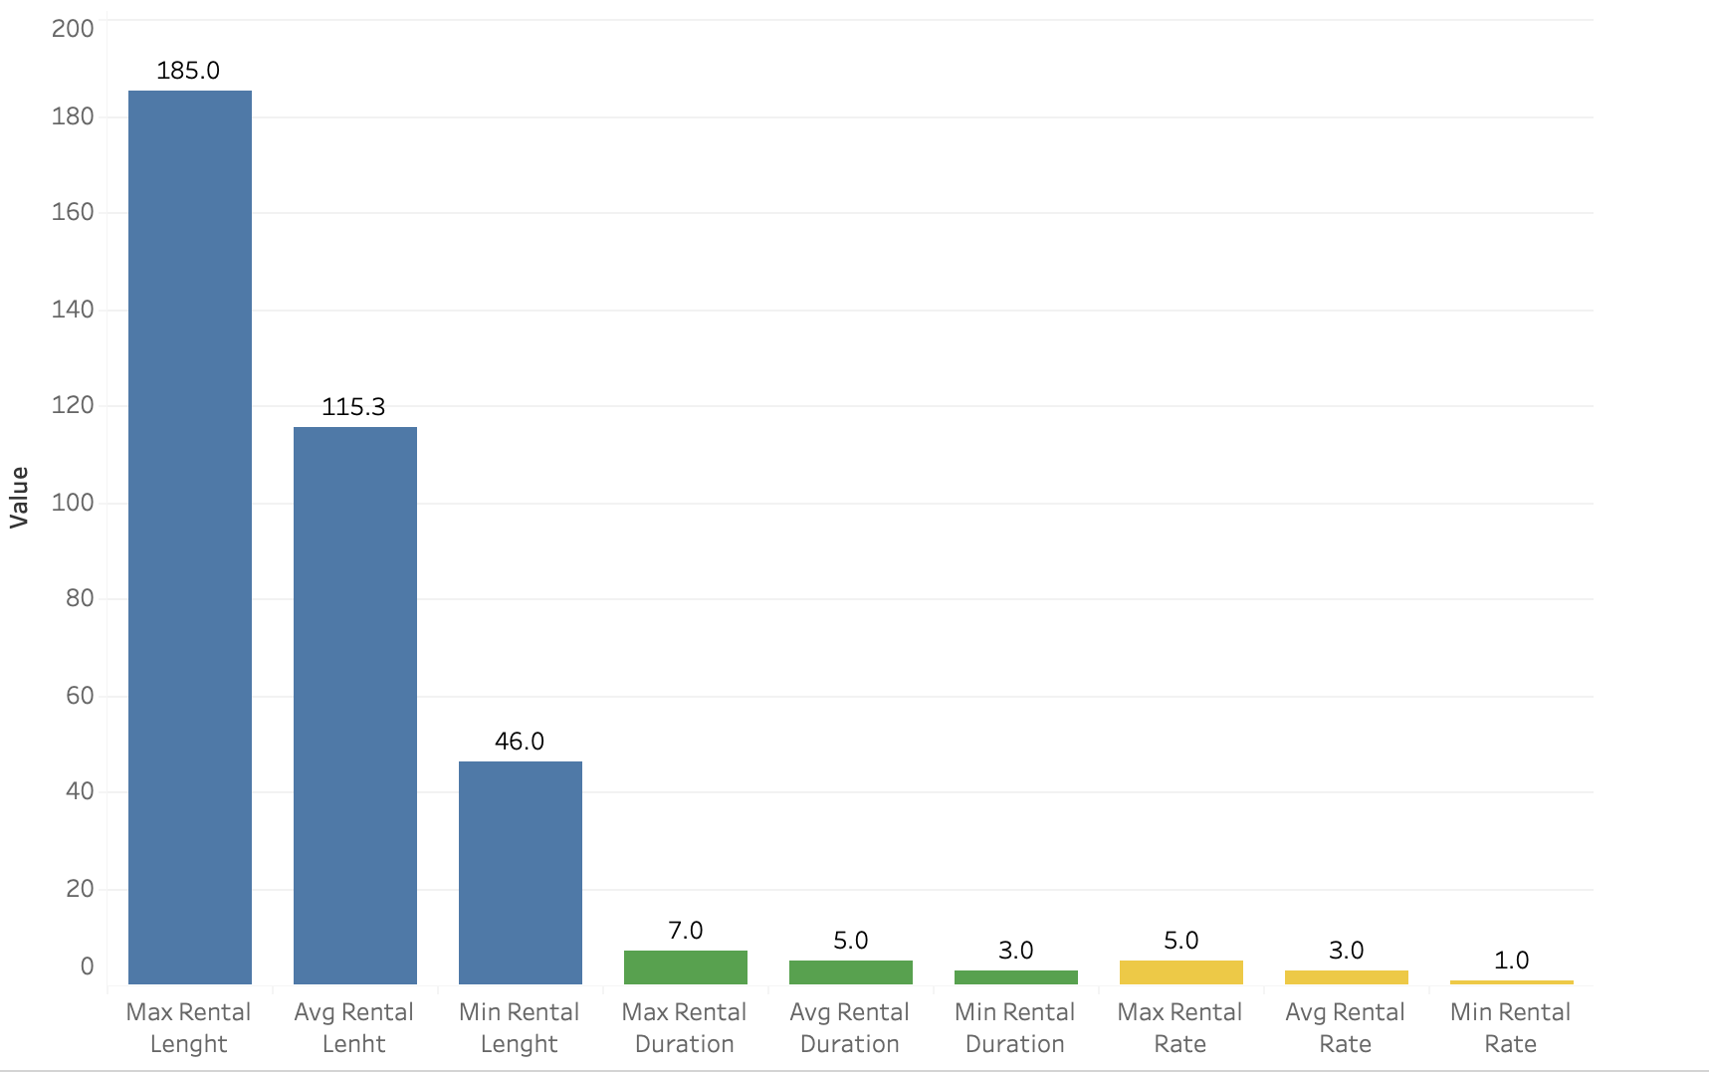
Descriptive Analysis of the Minimum, Maximum, and Average Rental Duration, Rental Rate, and Rental Length

Slide 8
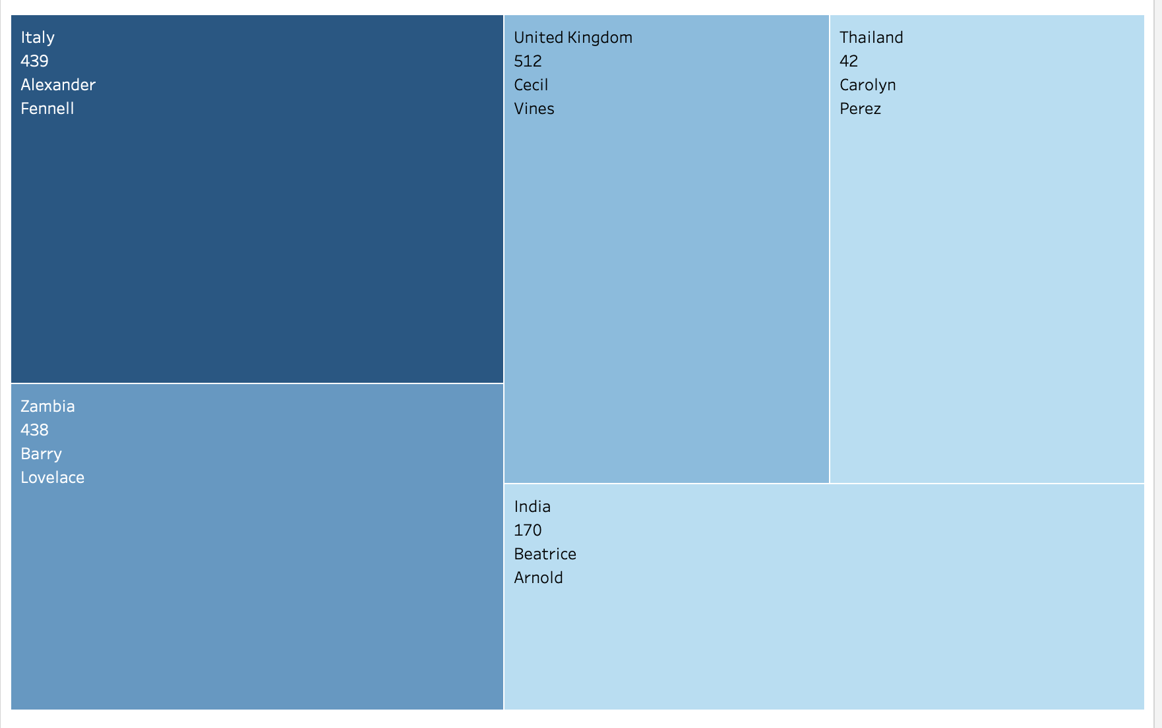
Top 5 Customer by City and Country

Slide 9

Best Sales Personnel
Name: Mike Hillyer
Sales Count: 8040

Slide 10
Revenue Maximization by Geography: Focus marketing and customer retention efforts on cities and countries that generate the highest payments. Identify the top 5 cities and countries based on total customer payments. Allocate more marketing resources and promotional efforts to those areas to increase revenue. Additionally, offer personalized incentives to high-paying customers in these regions.
Recommendations
Geographic Expansion : Expand into cities and countries that have potential for higher customer payments but are currently underperforming. After identifying cities or countries with high customer payments, also highlight those regions that show high growth potential (large populations with relatively low revenue). Target these areas for expansion and increased customer acquisition efforts.
Customer Segmentation and Targeted Promotions: Increase customer lifetime value by offering targeted promotions. Segment customers in top-paying cities and countries by payment behavior. Offer targeted discounts or special offers to customers who have made significant payments but might not be fully engaged with the platform (e.g., infrequent users with high average payments).

Slide 11
Conclusion
By focusing on these targeted recommendations, Rockbuster can boost its overall revenue, strengthen its presence in profitable regions, and expand into new, high-potential markets in 2020.

Slide 12
Thank You
Tableau Url: https://public.tableau.com/app/profile/julia.petke/viz/RockbusterStealthsbusiness2020BusinessStrategy/Top10Countriesbycustomernumbers

